Slide 1
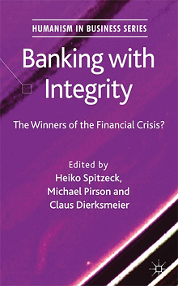
Banking with Integrity
Edited by: H. Spitzeck, M. Pirson & C. Dierksmeier
A Palgrave Macmillan Publication from the Humanism in Business Series.
Banking with Integrity tells the stories of banks which were doing well during the financial crisis of 2007-2010. While other banks went bankrupt, were nationalized, or struggled for survival, some of our featured cases increased their market share, attracted more customers and avoided home evictions of their clients.
Banking with Integrity looks at the healthier population of financial service firms to find reasons for their resilience.
Full Citation: Banking with Integrity, Spitzeck, H., Pirson, M., Dierksmeier, C. (Eds.) (2011). Houndmills: Palgrave Macmillan

